Slide 1

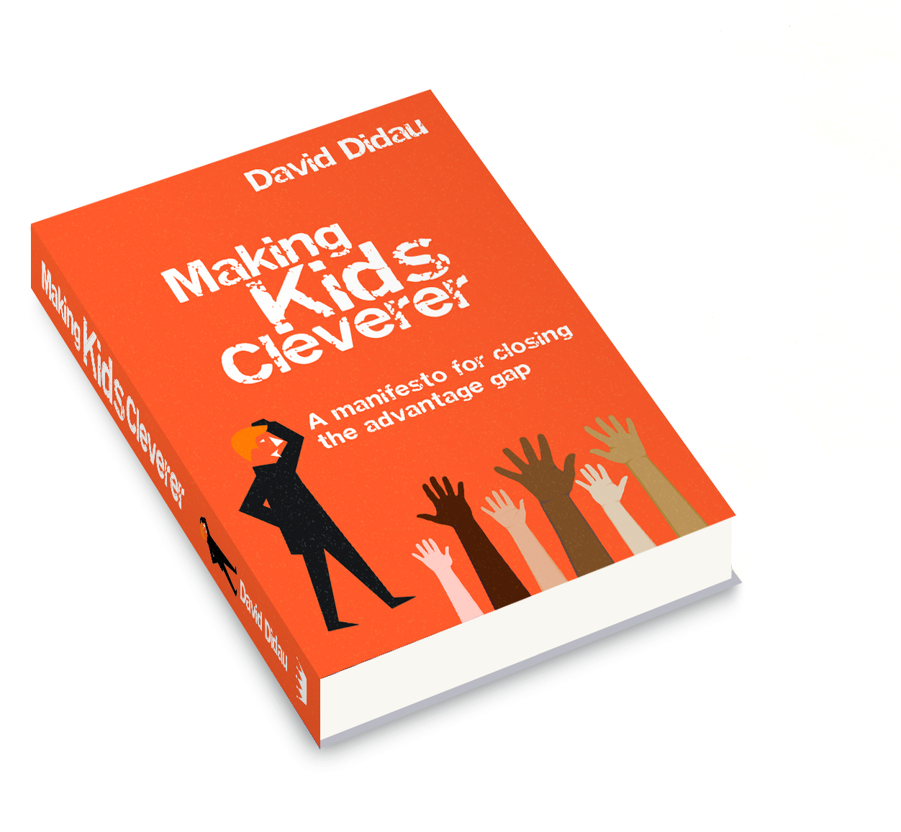

Curriculum related expectations: aligning curriculum & assessment
The Romero MAC conference
22nd October 2021
@DavidDidau

Slide 2
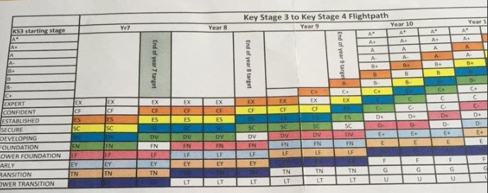
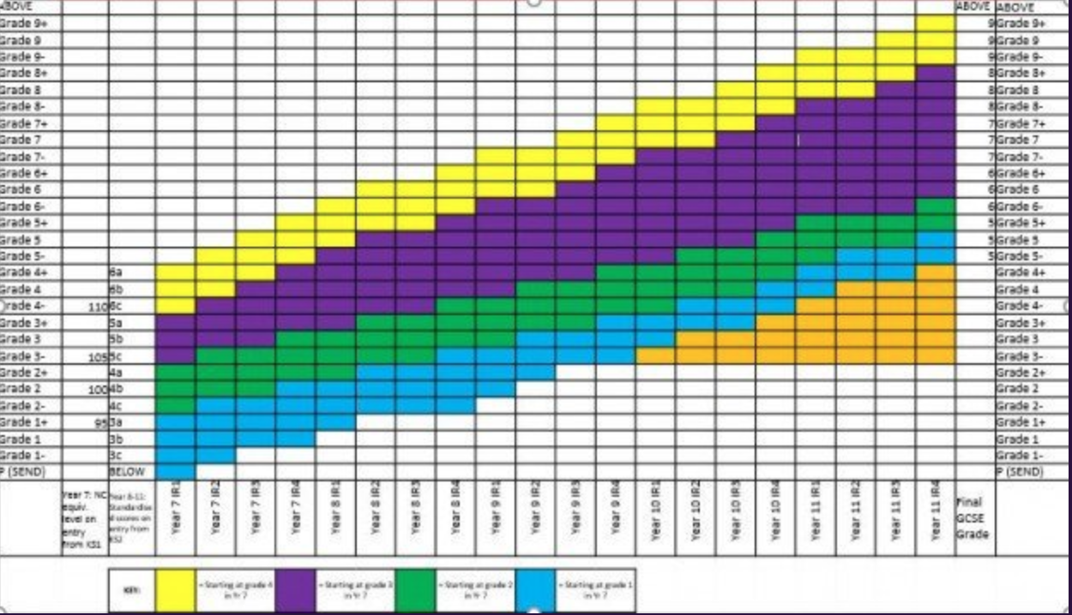
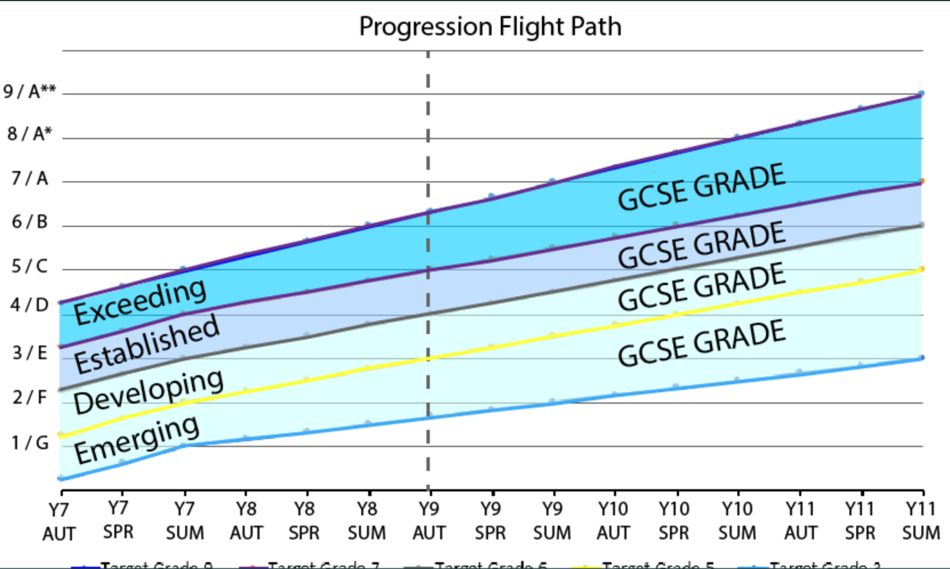
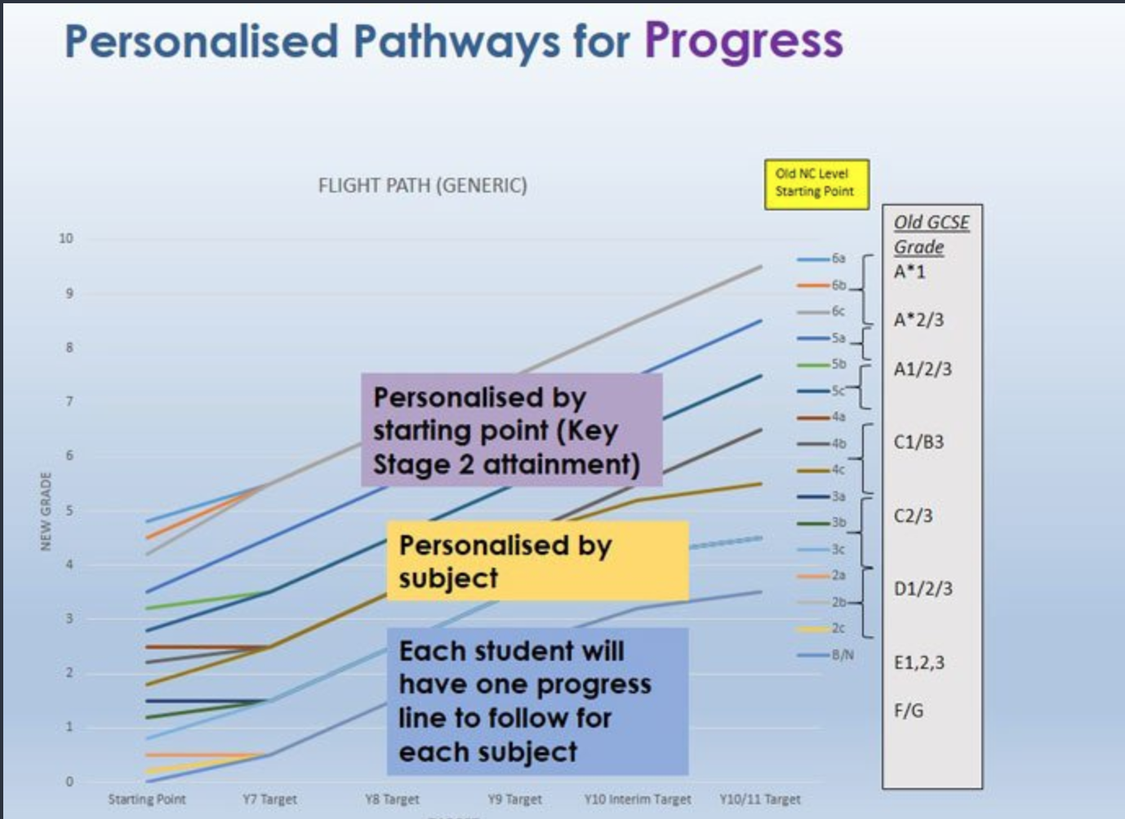
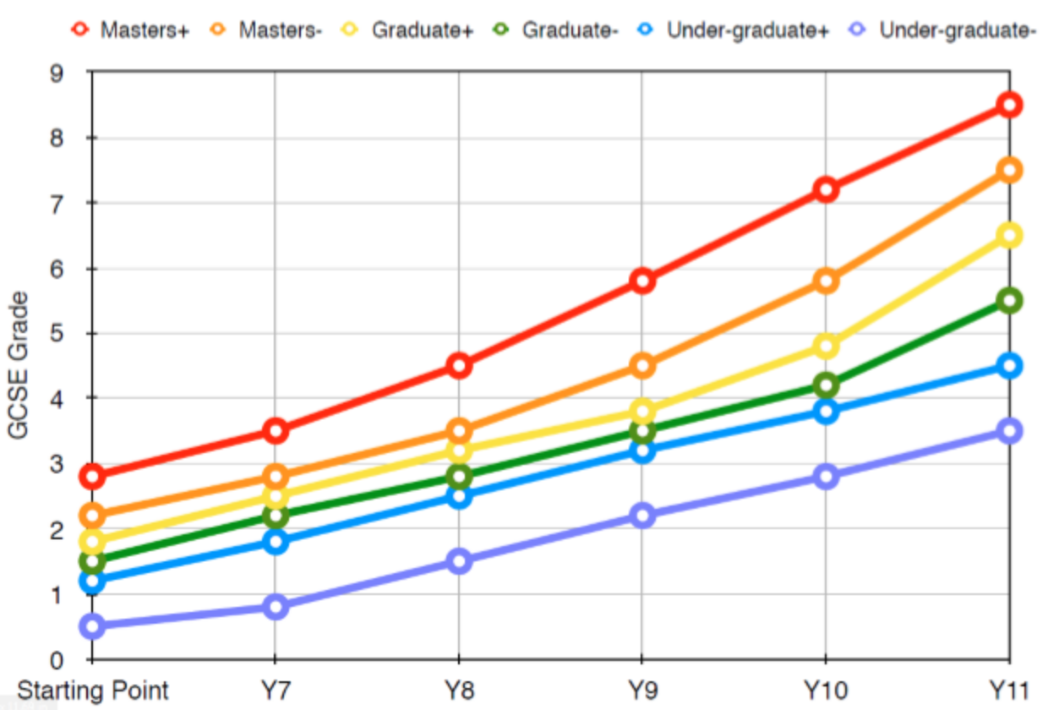
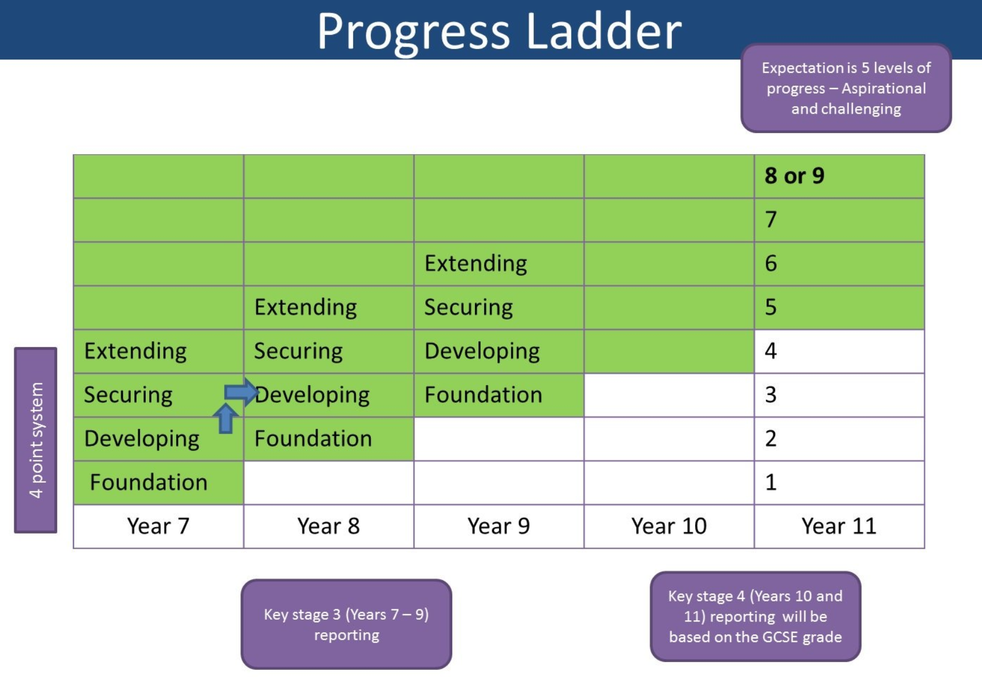
How not to use the curriculum as a progression model
“Flight paths in secondary are nonsense and demotivating for pupils.”
Sean Harford, Ofsted, National Director of Education

Slide 3
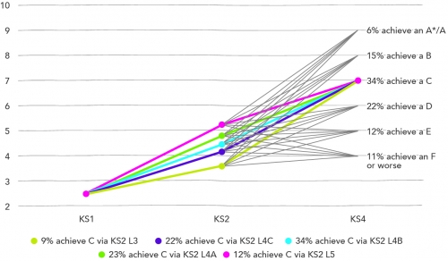
“More children get to the ‘right’ place in the ‘wrong’ way, than get to the ‘right’ place in the ‘right’ way.”
Treadaway 2015

Slide 4
The problem with flight paths
Beliefs matter
Predictions can become self fulfilling prophesies
Predictions are probabilistic – they are only ever accurate on average.

Slide 5
The problem with Age Related Expectations
They’re guesswork: we use ‘what some children can do’ as a guide to suggest ‘what all children should do’
They don’t help us understand why expectations are (or aren’t) met
Instead, we need curriculum related expectations.

Slide 6
What does it mean to use the curriculum as a progression model?
What if progressing through the curriculum doesn’t result in students making progress?
How do we know if students know, remember and can do more of the curriculum?
What should we do with assessment data?

Slide 7
What if progressing through the curriculum doesn’t result in students making progress?
The curriculum isn’t good enough if
  It’s not specific enough about what students need to know, remember and be able to do
  It’s not coherently sequenced to ensure students are able to make progress
As a result, students are
  assessed on things they haven’t been taught
  don’t possess the requisite knowledge to be able to do what is being assessed
Teach what will be assessed and only assess what has been taught.

Slide 8
Curriculum Related Expectations
What specifically do we want students to know and be able to do?
  Bad: students will learn how to write an analytic essay
  Better: students will learn how to scaffold an analytic essay as a ‘conversation’ between 2 points of view (they say/I say)
  Best: students will learn how to write a thesis statement beginning with a subordinating conjunction and using a list of triple/quadruple adjectives to frame the arguments they will develop
These must be reasonable expectations of what students should learn
The more specific you are, the more likely you are to teach and assess what has been specified.

Slide 9
Progression within subjects
Is your subject more hierarchical (tall) or more cumulative (wide)?
Learning progressions must be:
  Inherently empirical – based on how children actually learn the thing
  Inherently local — what we focus on is our choice.

Slide 10
Curriculum Related Expectations
How much of the curriculum have students mastered?
Curriculum Related Expectations allow us to specify, teach and assess what students should learn
So, what is it we want students to learn?
If we can’t specify it, we’ll struggle to teach or assess it.

Slide 11
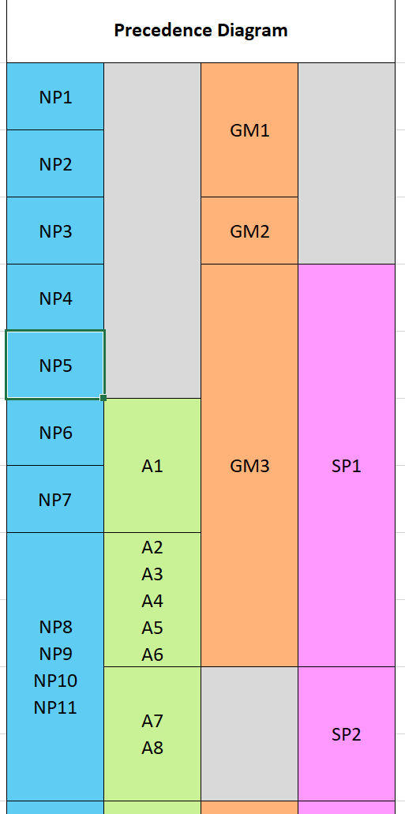
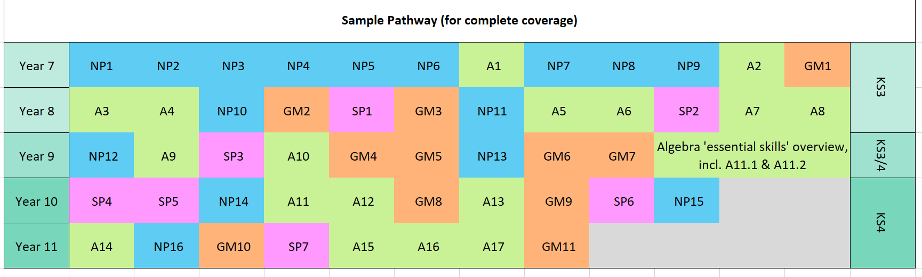
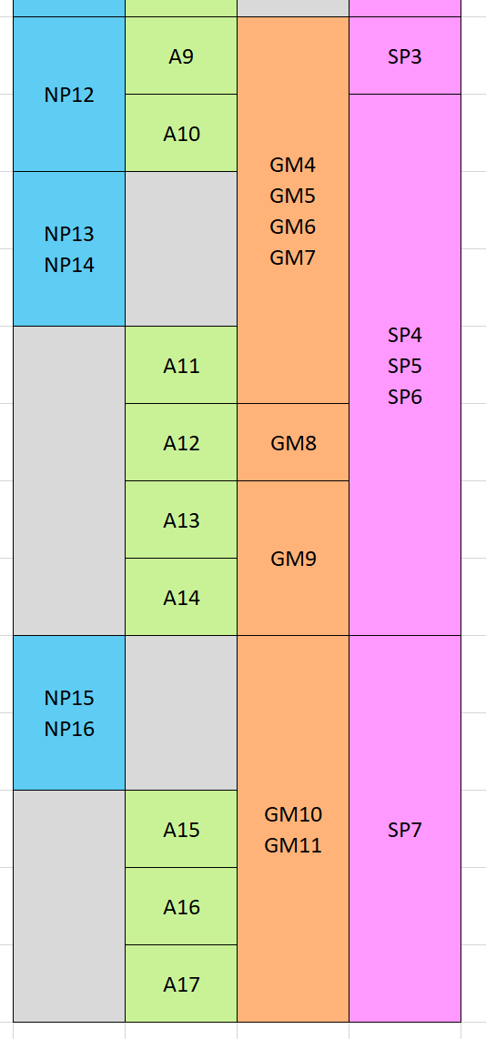
Specifying the mathematics curriculum

Slide 12
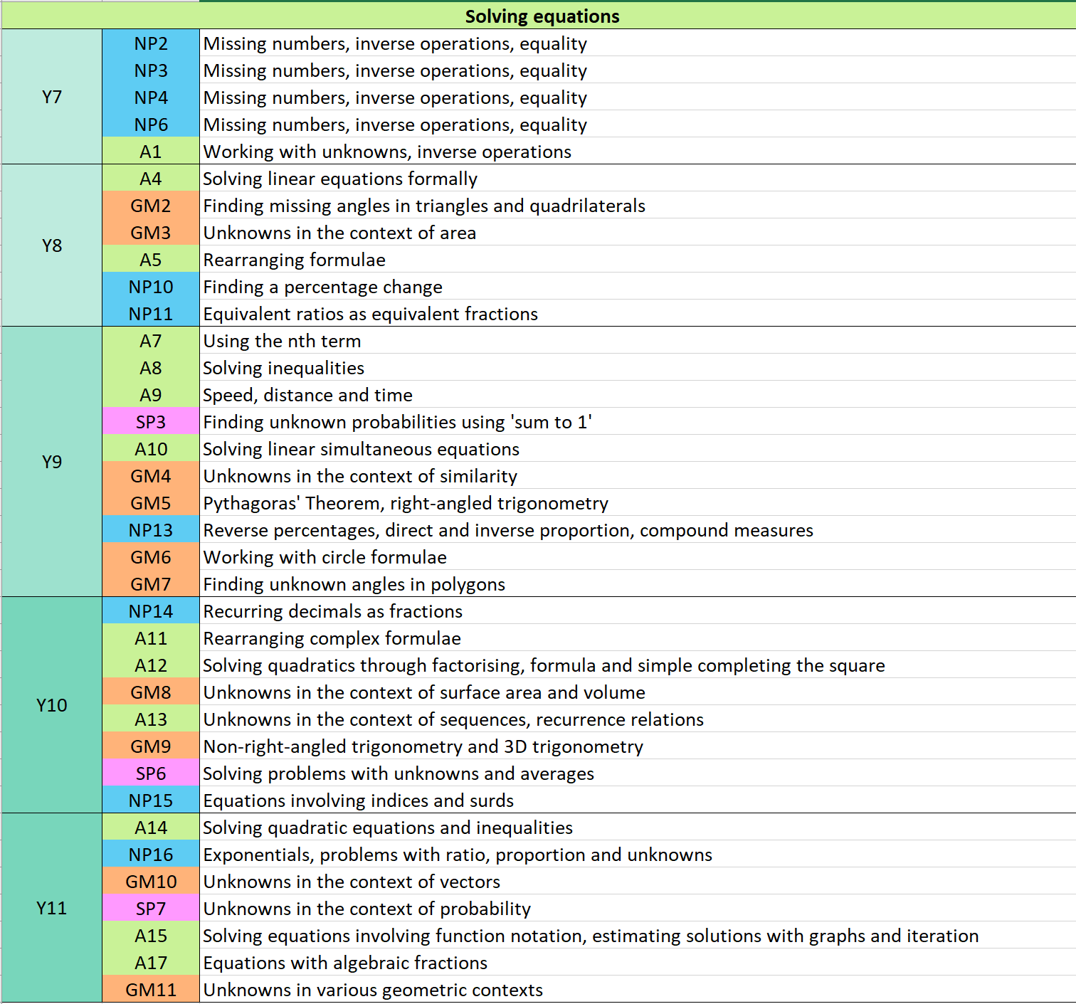
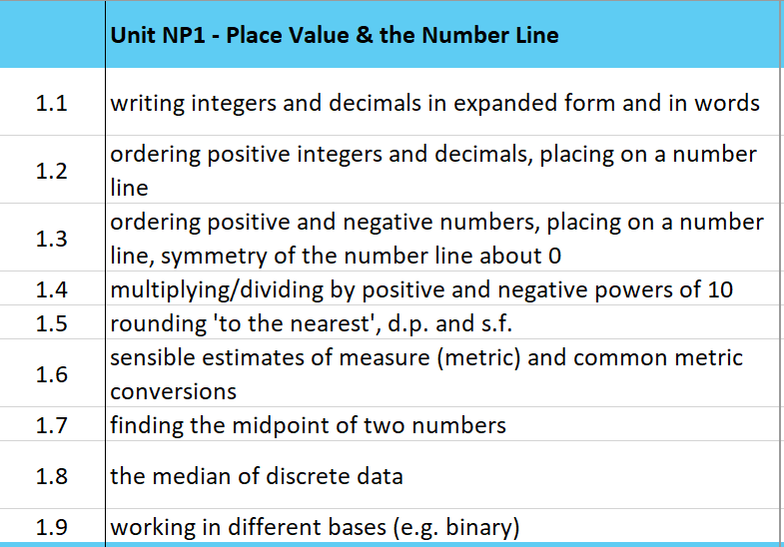
Specifying the mathematics curriculum

Slide 13
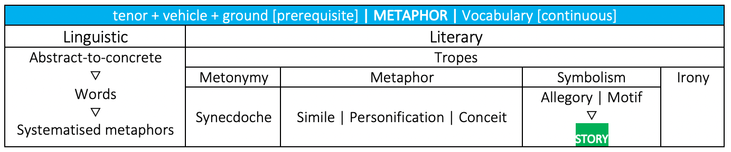
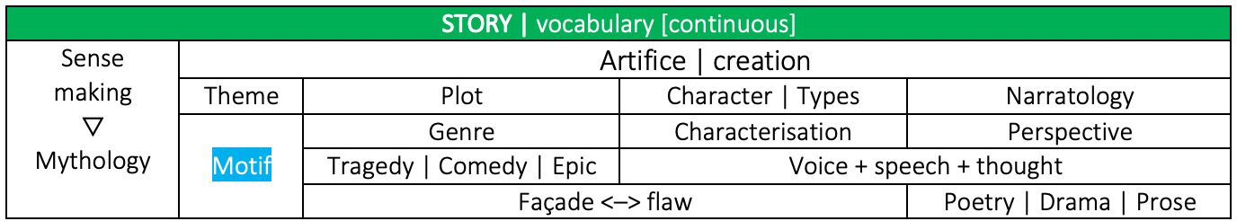
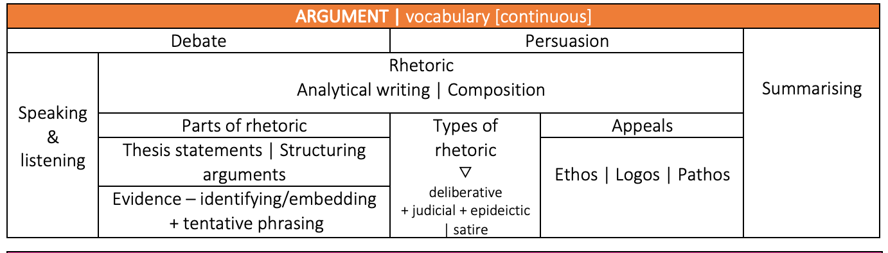
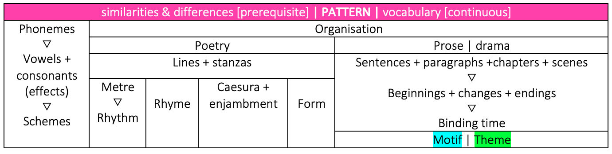
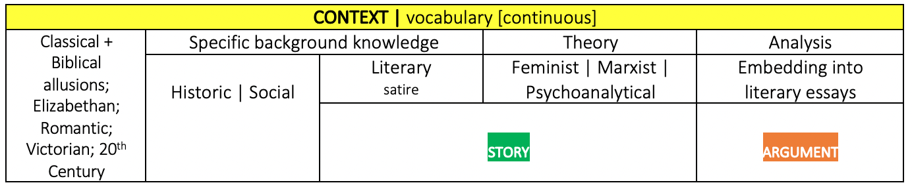
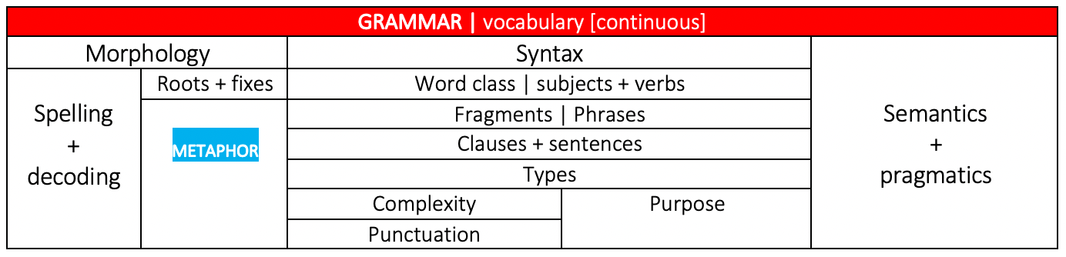
Specifying the English curriculum

Slide 14
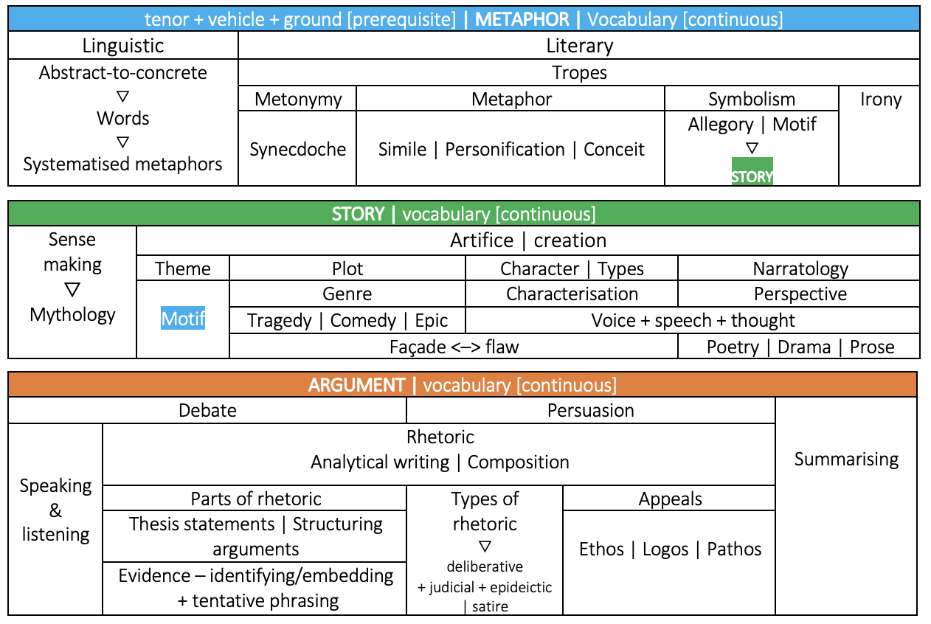
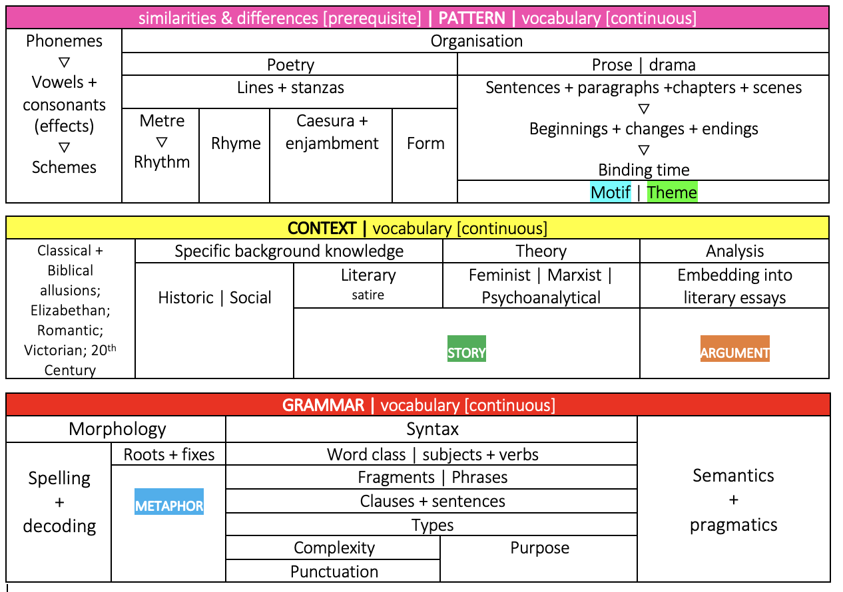
Specifying the English curriculum

Slide 15
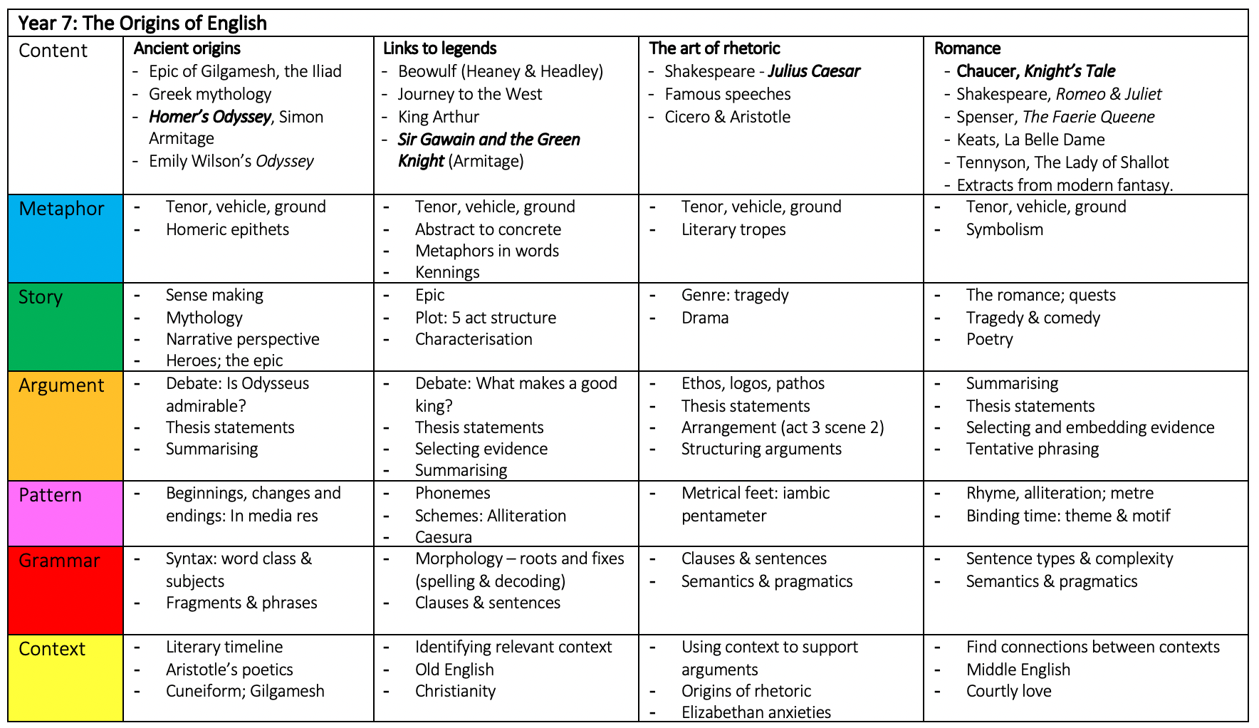
Specifying the English curriculum

Slide 16
Potential benefits of CREs
The lack of emphasis on raising students’ rank means that the curriculum is less likely to be warped by proxies
Less need to reify and quantify aspects of the curriculum
Clearer sense of what has been taught effectively
More precise knowledge of what each student has and has not learned
Clearer sense of what needs to retaught
Greater clarity of which students require intervention in which areas
No need to assign global grades of competence to individual students
Less risk that students who have not met a CRE are likely to view this an an inherent quality
Less risk of students seeking the external validation of a grade.

Slide 17
2. How do we know if students know, remember and can do more of the curriculum?
In-lesson formative assessment
Checking whether students know, remember and can do the things you have been teaching them and then acting on the outcomes of this assessment
Formal summative assessments
How often?
What should they look like?

Slide 18
Instructional response
Did all students answer the item correctly?
Did any of students answer the item correctly?
Have all students correctly answered this kind of item before?
No
No
Yes
Yes
Move on to the next area of the curriculum but include regular retrieval practice
Provide regular retrieval practice of this aspect of the curriculum alongside targeted support for those that have not yet grasped the concepts
No
This aspect of the curriculum needs reteaching with careful thought given to the design of the instructional sequencing
Did most students answer the item correctly?
No
Yes
Provide frequent retrieval practice of this aspect of the curriculum

Slide 19
Year 7 - test 1
NP1 – NP6
Year 7 - test 2
NP1 – NP6
A1 – A2
NP7 – NP9
GM1
Adapted from Advantage Schools
Year 8 - test 1
NP1 – NP9
A1 – A2
GM1
A3 – A4
NP10
GM2 – GM3
SP1
Year 8 - test 2
NP1 – NP10
A1 – A4
GM1 – GM3
SP1
NP11
SP2
A5 – A8
Year 9 - test 1
NP1 – NP9
NP10 – NP11
A1 – A8
GM1 – GM3
SP1 – SP2
NP12
A9 – A10
GM4
SP3
Year 9 - test 2
NP1 – NP9
NP10 – NP12
A1 – A10
GM1 – GM4
SP1 – SP3
GM5 – GM7
NP13

Slide 20
Year 7 - test 1
Ancient origins
Links to legend
Year 7 - test 2
Ancient origins & Links to legend
Art of Rhetoric
Romance
Adapted from Advantage Schools
Year 8 - test 1
Ancient origins & Links to legend
Art of Rhetoric
Romance
The sonnet form
Religion & superstition
Year 8 - test 2
Ancient origins
Art of Rhetoric
Romance
The sonnet form
Religion & superstition
COMEDY
Story of the novel
Year 9 - test 1
Ancient origins
Art of Rhetoric
Romance
The sonnet form
Religion & superstition
COMEDY
Story of the novel
The Gothic
War writing
Year 9 - test 2
Ancient origins
Art of Rhetoric
Romance
The sonnet form
Religion & superstition
COMEDY
Story of the novel
The Gothic
War writing
Tragedy
Freedom
Women in Literature

Slide 21
3. What should we do with assessment data?
The specificity problem: How specific do Curriculum Related Expectations have to be in order to be useful?
  If they’re too specific we risk generating endless tick box checklists (No one wants a return to APP!)
  If they’re too broad they risk becoming meaninglessly bland.
CREs need to be both very specific and very broad…
…depending on the audience.

Slide 22
What do students need to know?
Where am I?
Where am I going?
How am I going to get there?

Slide 23
What do teachers need to know?
Gaps to fill (individuals and class)
next steps; effectiveness of instruction/curriculum
Responsiveness applies at a curricular as well as instructional level.

Slide 24
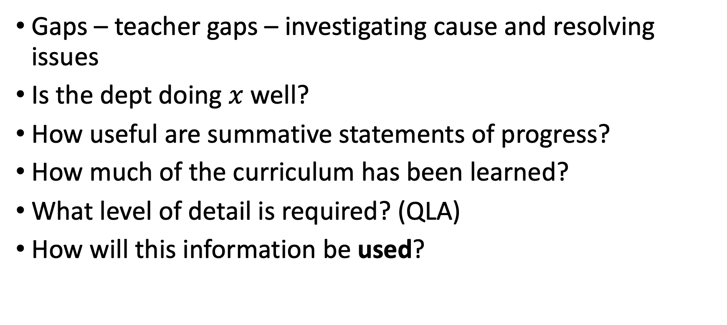
What do curriculum leaders need to know?
Gaps – teacher gaps – investigating cause and resolving issues
Is the dept doing $x$ well?
How useful are summative statements of progress?
How much of the curriculum has been learned?
What level of detail is required? (QLA)
How will this information be used?

Slide 25
What do SLT/Governors need to know?
A summary – Which teachers need development? Is the cohort on track?
Can (should) this information be reported with average percentages?
NB Grades are holistic and can ONLY be applied summatively after a course is complete.

Slide 26
What do parents need to know?
How is my child performing (relative to other members of the group)?
Are they working hard? (What, specifically, do they need to improve?)
Are they happy?

Slide 27
Is there a role for numbers?
A student’s performance in an assessment is 64%. Is this good or bad?
The average performance in the class was 57%
The average performance in the year group was 79%
Information is meaningful if it is comparable
But, a system that communicates numerical aggregates doesn’t answer Wiliam’s questions (Where am I? Where am I going? How am I going to get there?)

Slide 28
Where numbers go wrong
How do we know if one test is more difficult than another?
What should we infer if a student gets 70% in test 1 and 30% in test 2?
Lateral comparisons allow us to compare different students’ performance on the same test
Comparing longitudinally – across different tests – inevitably leads to false conclusions.

Slide 29
An example: mathematics
Year 7 - test 1
NP1 – NP6
Students:
“The areas you need to practise more are rounding to significant figures and ordering decimals. We have assigned you tasks on these topics to complete by …”
Teachers:
“My class average was 60% and the parallel set got 72%. I can see that my group did much worse on ordering decimals, so I’ll talk to the department and see what ideas they have.”
HoDs:
“Across the board, rounding to significant figures wasn’t as good as it needs to be. We will revisit it soon and spend some department time on it in the meantime. Teacher C needs some support with their class as the results aren’t where they ought to be.”
SLT/Governors:
“Year 7 are mostly attaining well on the maths curriculum this year, so will be ready for Year 8. Teacher C’s group is a little concern. We will spend time with the HoD to check what’s happening and how we might support.”
Parents:
“Your child achieved 65%. The class average was 72% and the cohort average was 70%. She has spent 50% less time on Dr Frost Maths than the rest of the class. She will now be assigned tasks on rounding to significant figures and ordering decimals in order that she does not fall behind.”
In the curriculum documentation:

Slide 30
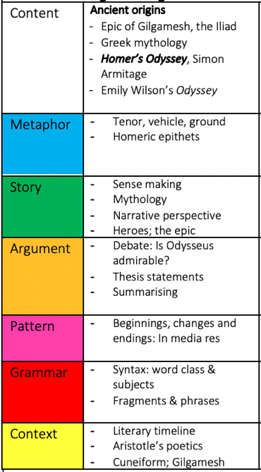
An example: English
Year 7 - test 1
Ancient origins & Links to legend
Students:
“The areas you need to practise more are analysing the connections between the tenor and vehicle of metaphors and beginning thesis statements with subordinating conjunctions. We have assigned you tasks on these topics to complete by …”
Teachers:
“My class average was 60% and the parallel set got 72%. I can see that my group did much worse on using subordinate clauses and explaining narrative structure, so I’ll talk to the department and see what ideas they have.”
HoDs:
“Across the board, rounding to significant figures wasn’t as good as it needs to be. We will revisit it soon and spend some department time on it in the meantime. Teacher C needs some support with their class as the results aren’t where they ought to be.”
SLT/Governors:
“Year 7 are mostly attaining well on the Engl;ish curriculum this year, so will be ready for Year 8. Teacher C’s group is a little concern. We will spend time with the HoD to check what’s happening and how we might support.”
Parents:
“Your child achieved 65%. The class average was 72% and the cohort average was 70%. She needs to practice writing one sentence thesis statements and analysing metaphor. She has been assigned tasks on rounding to these areas in order that she does not fall behind.”
In the curriculum documentation:

Slide 31
Ormiston Park Academy
In practice: Specifying ‘core’ knowledge

Slide 32
Live tracking and reporting of progress
OPA - LIVE PROGRESS TRACKER Year 10 HISTORY
M/F | SEN | FSM/ Care | Name | Year | TG | Tutor | Class | E | D | S
Can you explain two features of English society in 1509 | Can you explain a success and failure of the Treaty of London, Field of the Cloth of Gold, Battle of Spurs and Battle of Flodden | Can you explain 3 reasons for the execution of Anne Boleyn | Can you explain 3 reasons for the dissolution of the monasteries | Explain 3 reasons for the Pilgrimage of Grace, 3 key features and 3 consequences | Can you explain 3 reasons, key features and consequences of Brown v Board of Education | Can you explain 2 reasons, 3 key features and 3 consequences of Little Rock
BAGOCIUS, Titas | Year 10 | 10En SHR/SAM | SHR/SAM | 10A/Hi1 BAR | 8 | 1 | 9 | S | S | S | S | D | S | S
BRION, Awuraba | Year 10 | 10Sc DUR/ABE | DUR/ABE | 10A/Hi1 BAR | 8 | 2 | 8 | S | S | D | S | D | S | S
CARTER, Harry | Year 10 | 10Sc DUR/ABE | DUR/ABE | 10A/Hi1 BAR | 8 | 3 | 7 | S | S | D | D | D | S | S
FARMER, Grace | Year 10 | 10En MAB/COL | MAB/COL | 10A/Hi1 BAR | 11 | 6 | 1 | D | D | E | E | E | D | D
HOCKLEY, Emily | Year 10 | 10Ma HOQ | HOQ | 10A/Hi1 BAR | 9 | 6 | 3 | S | D | D | D | E | D | D
KAZMI, Ali | Year 10 | 10Ma MUB/FAI | MUB/FAI | 10A/Hi1 BAR | 8 | 3 | 7 | S | D | S | S | D | S | S
KEENAN, Leom | Year 10 | 10Ma HOQ | HOQ | 10A/Hi1 BAR | 13 | 1 | 4 | S | E | E | E | E | S | S
MADANI, Maria | Year 10 | 10Ma MUB/FAI | MUB/FAI | 10A/Hi1 BAR | 8 | 5 | 5 | S | D | S | D | D | D | D
MONKHOUSE, Charlie | Year 10 | 10Ma HOQ | HOQ | 10A/Hi1 BAR | 9 | 5 | 4 | S | D | D | D | D | D | S
OBI, Chidera | Year 10 | 10Sc DUR/ABE | DUR/ABE | 10A/Hi1 BAR | 8 | 5 | 5 | S | D | S | S | D | D | D
SALIAJ, Kledis | Year 10 | 10En MAB/COL | MAB/COL | 10A/Hi1 BAR | 9 | 7 | 2 | D | D | D | D | E | D | D
STAVREVA, Sylvia | Year 10 | 10Sc DUR/ABE | DUR/ABE | 10A/Hi1 BAR | 9 | 0 | 9 | S | S | S | S | E | S | S
STEEL, Riley | Year 10 | 10Sc DUR/ABE | DUR/ABE | 10A/Hi1 BAR | 9 | 3 | 6 | S | S | D | S | E | D | S

Slide 33
Key points
No one is asking for internal data – if you are going to produce it you need to have a very clear rationale
Only assess what students have been taught
Data can help to make comparisons but is unlikely to help students make progress
Students are making progress if they know more, remember more and are able to do more of the curriculum
To be used as a progression model the curriculum must be both highly specific and carefully sequenced.

