Slide 1
All Saints and All Souls

Slide 2
Sign of the cross

Slide 3
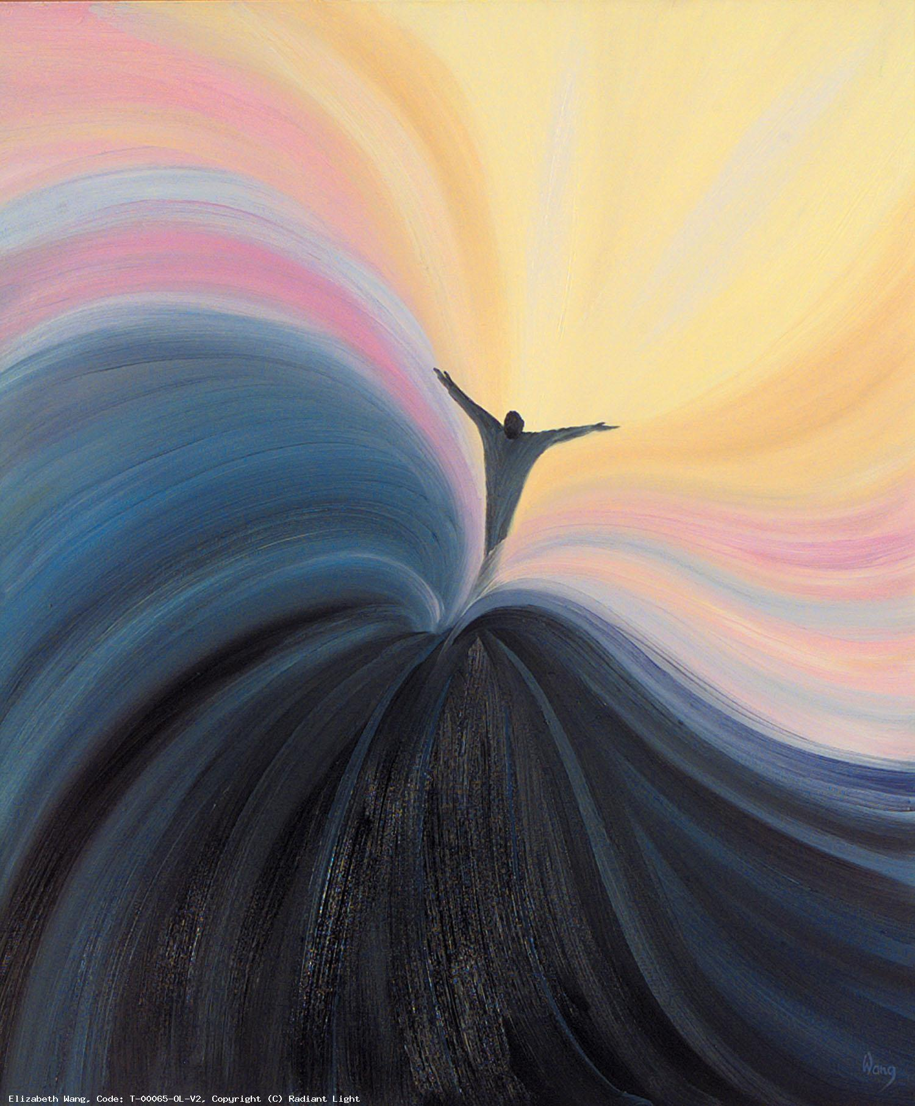
We Gather
We Listen
We Respond
Mission

Slide 4
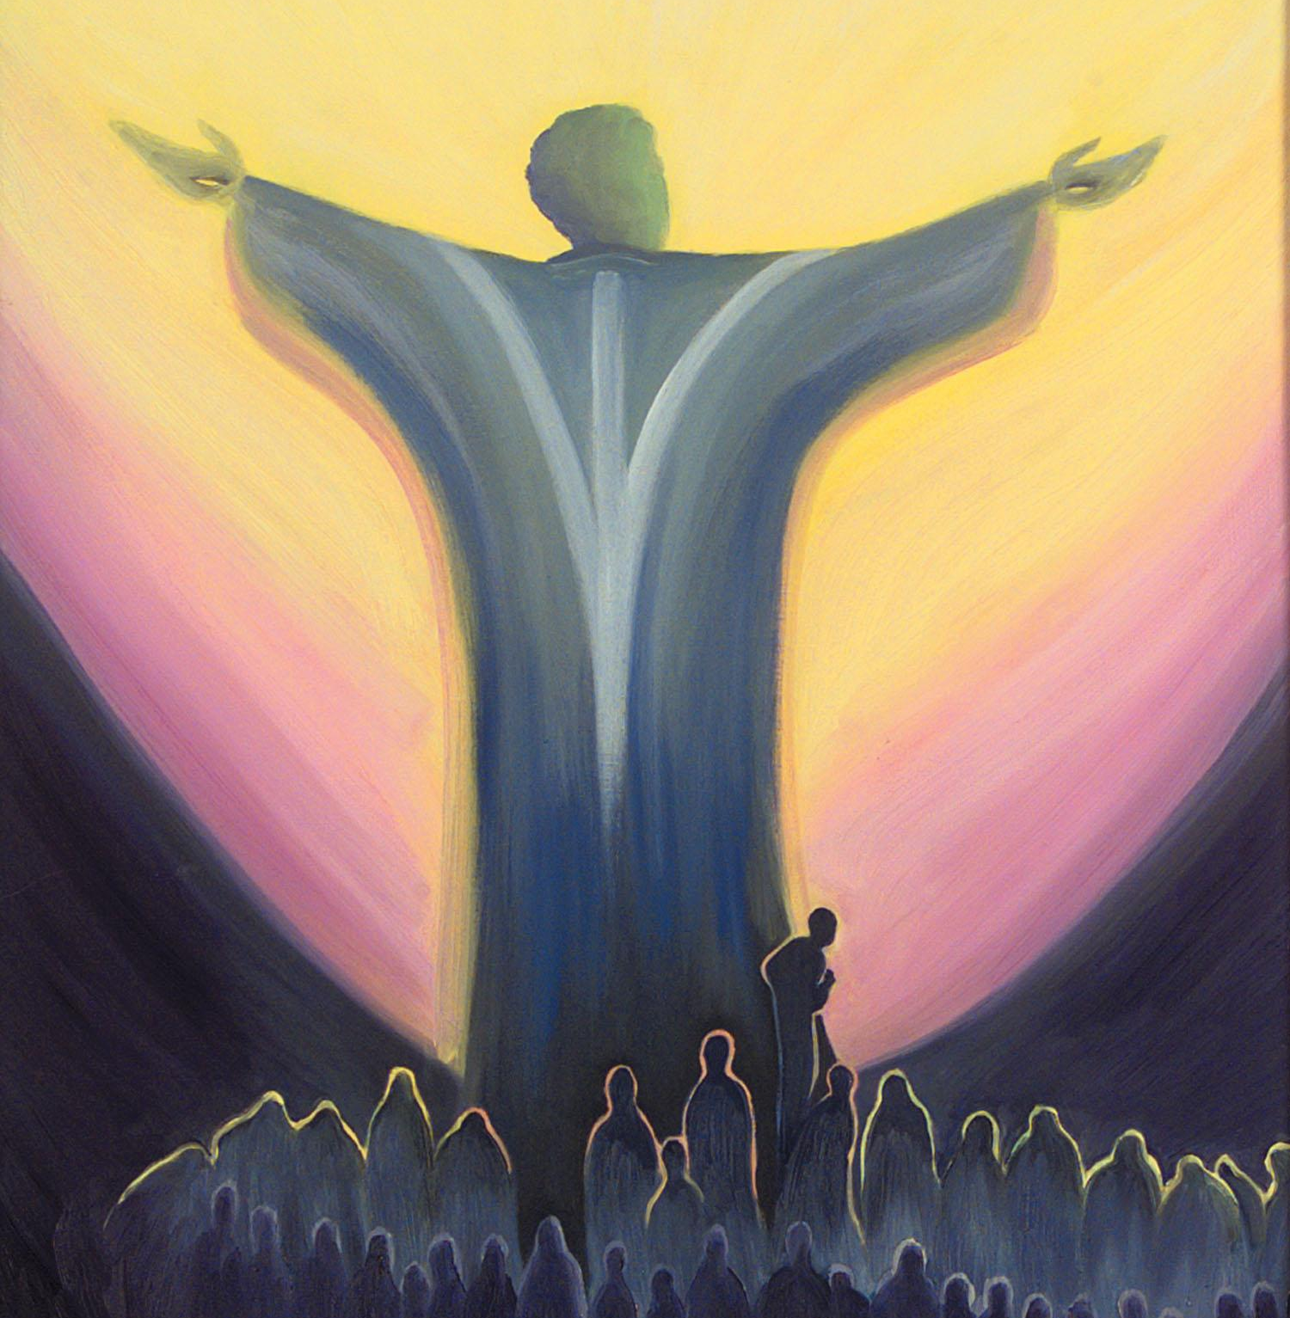
We Gather
Notes:
As we gather on this second day in November, we acknowledge that this is a month in which remember all the departed.
Family members and friends and those in our school communities
This month is also a time of national remembrance when we recall those who have dies for our country in wars, in the cause of peace.

Slide 5
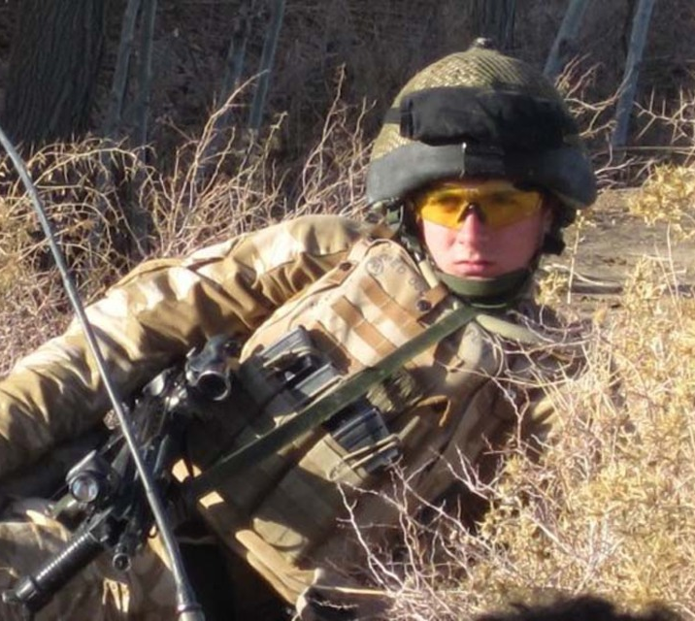
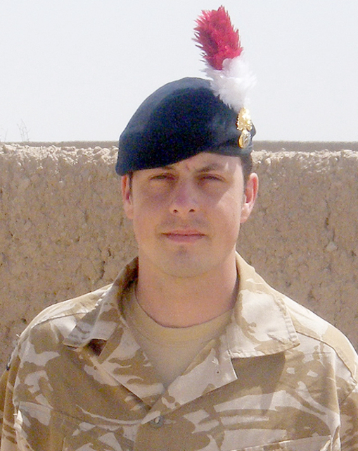
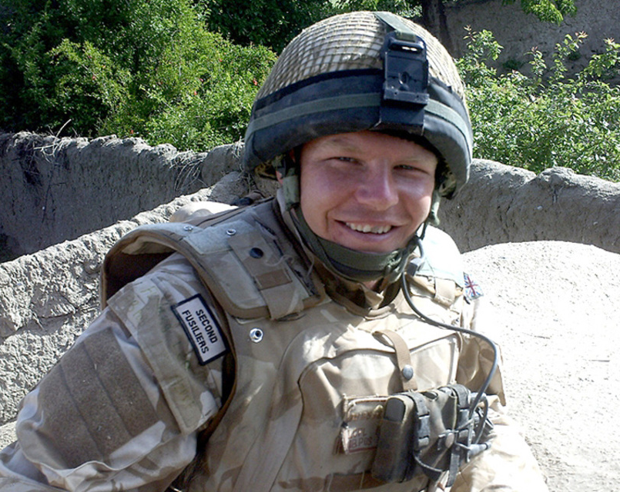
Guy Mellor Shaun Bush James Fullarton

Slide 6
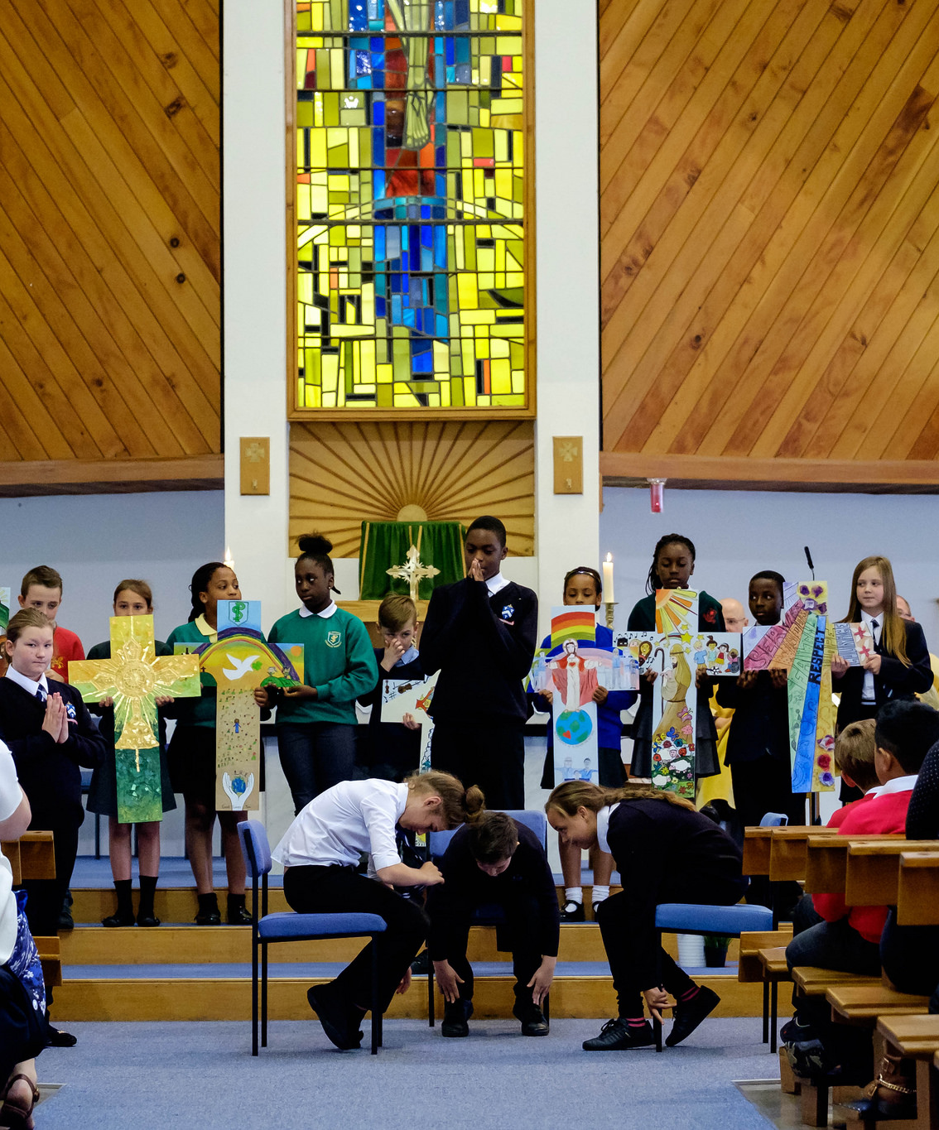
A representative is invited to bring a candle representing the ten entities
Cardinal Wiseman Laura Burtonwood
Corpus Christi Charlotte Miller
Good Shepherd Michael Kirby
Sacred Heart Rachel Ellis
SS Peter and Paul Michelle Garvey
Saint Gregory Debbie Enstone
Saint John Fisher Pauline Finn
Saint Patrick Danielle Kingham
Blue Sky TSA Laura Stevenson
Shared Services Patrick Taggart Team

Slide 7
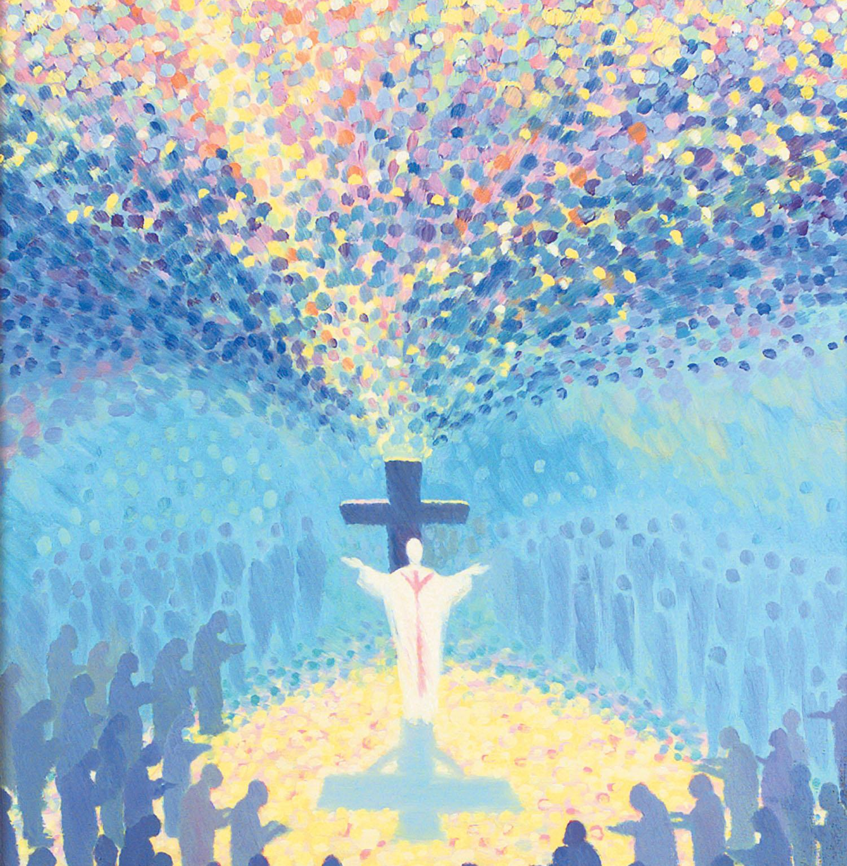
We Listen

Slide 8
Matthew 5 Read by Colin Beesley
Assistant Vice Principal Cardinal Wiseman Staff Director
Gospel
Matthew 5:1-12a
How happy are the poor in spirit
Seeing the crowds, Jesus went up the hill. There he sat down and was joined by his disciples. Then he began to speak. This is what he taught them:
……..‘Happy the pure in heart: they shall see God.
Happy the peacemakers: they shall be called sons of God.
….Rejoice and be glad, for your reward will be great in heaven.’
The Gospel of the Lord ALL: Praise to you Lord Jesus Christ

Slide 9
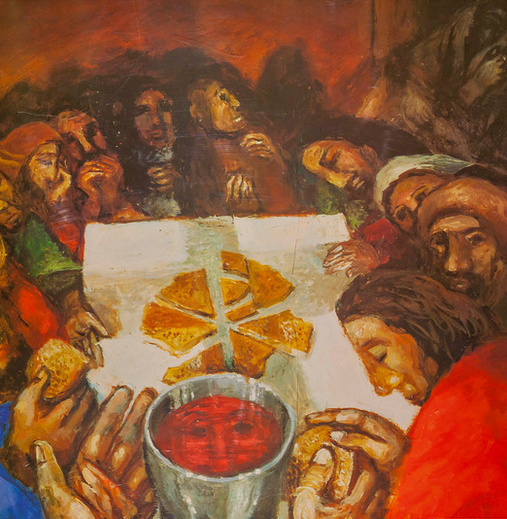
We Respond

Slide 10
Franceska and Cosmin Head girl and boy Cardinal Wiseman
As one faith community, during this month of November we reflect on the prayer of St Francis
Lord, make me an instrument of your peace,
Where there is hatred, let me sow love;
Where there is injury, pardon;
Where there is doubt, faith;
Where there is despair, hope;
Where there is darkness, light;
Where there is sadness, joy;
O Divine Master,
Grant that I may not so much seek
To be consoled as to console;
To be understood as to understand;
To be loved as to love.
For it is in giving that we receive;
It is in pardoning that we are pardoned;
And it is in dying that we are born to eternal life. Amen.

Slide 11
Litany of Saints
Saint Peter ALL Pray for us
Saint Paul ALL Pray for us
Saint Gregory ALL Pray for us
Saint John Fisher ALL Pray for us
Saint Patrick ALL Pray for us
Saint Oscar Romero ALL Pray for us

Slide 12
Our Mission

Slide 14
Final prayer Monsignor Timothy Menezes; Prayers Before the Blessed Sacrament
Left side (towards ring road)
Lord Jesus Christ
The Saints of every place and time have known human frailty
Transformed in your image,
each Saint gives admirable witness of faith.
In these moments during November,
we reflect on the lives of Saints and
the inspiration it gives to us.

Slide 15
Final prayer
Right side
We pray for all the children, pupils and students
across our schools. That as faith communities,
we will make Christ known in their lives.
Through the inspiration of the Saints, give your
ordinary servants gathered here, the grace to do
extraordinary things.
We make this prayer through Christ our Lord
Left and right side Amen

Slide 16
We Will Remember – Mike Stanley
https://www.youtube.com/watch?v=ckM97kSinLw

Slide 17
Sign of the cross

