Slide 1
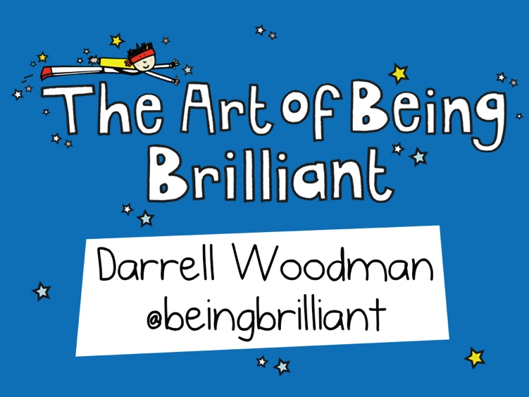

Slide 5
2.9013
‘Losada Line’
Positive to Negative Ratio

Slide 7
Positive Psychology
The science of happiness and well-being
You can learn to live in the upper reaches of your range of emotions
The more you practice the easier it becomes!

Slide 8
upper level (positive)
2%
‘mood hoovers’
lower level (negative)

Slide 10
90:10
10 % of a good life are the external factors we face
90% of a good life is how we choose to react to the 10%

Slide 11
Reticular
Activating
System

Slide 16
The 4-minute rule
The first 4 minutes of any interaction is the most important
Fake it for 4 minutes!

Slide 17
When do you use the 4 minute rule at work? How can you use the 4 minute rule more?
The 4 minute rule

Slide 19
‘brilliant recap’
What do you appreciate but take for granted too often?
Remind yourself who ‘You are at your best’
Recall 3 good things regularly (successes)
Doorman – you get what you focus on

